Slide 1
Climate Change: Elephant in the Board-room!
Praveen Gupta
Mumbai
November 7, 2019

Slide 2
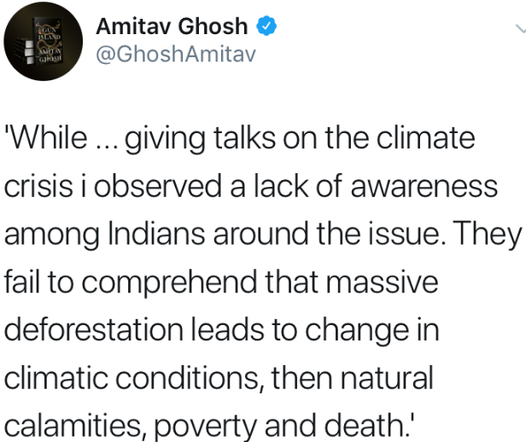
Setting the context!

Slide 3
What’s roasting the Planet?

Slide 4
What’s the big deal about
the
Paris Agreement?

Slide 5
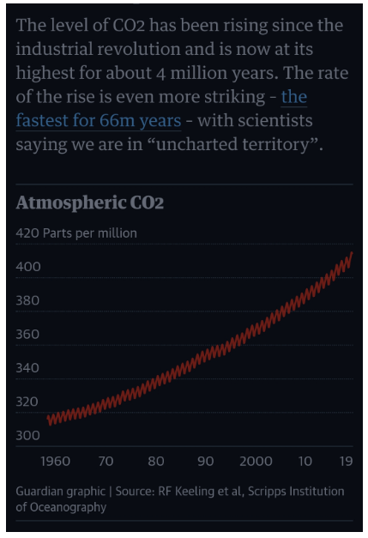
The ‘Villian’!

Slide 6
Top polluters!
Countries/ Region | Regional fossil fuel emissions (RFE) | Per-capita emissions (PCE) | Consumption-based fossil fuel emissions (CBE)
China | 27% | 7.0 t | 25%
Growth rates | + 1.7% | +4.7%
USA | 15% | 16.2 t | 16%
Growth rates | -0.5% | +2.5%
European Union | 10% | 28 t | 12%
Growth rates | 1.4% | -0.7%
India | 7% | 1.8 t | 6%
Growth rates | 4.0% | +6.3%
Source: www.globalcarbonprojects.org

Slide 7

Anthropocene!

Slide 8
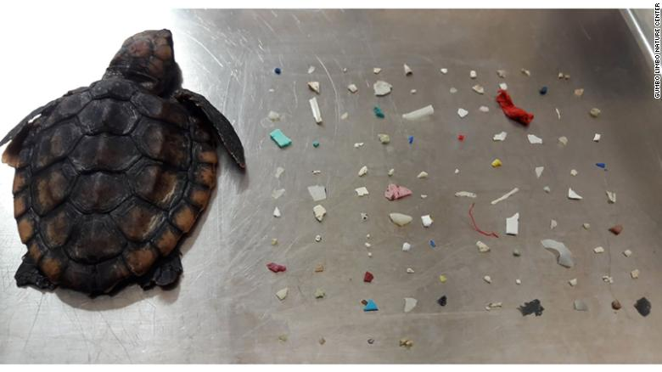
A baby turtle found with 104 pieces of plastic in its belly!
By Alaa Elassar, CNN

Slide 9
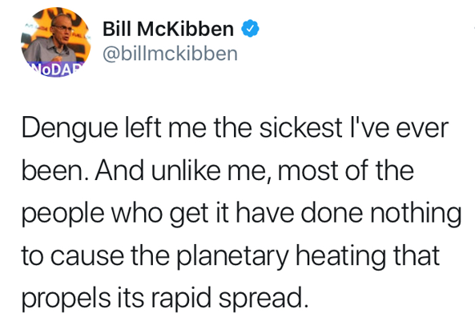

Slide 10
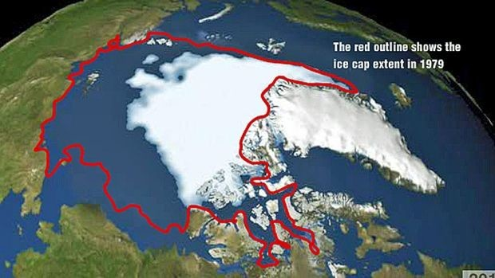
NASA watching!
Source: NASA

Slide 11
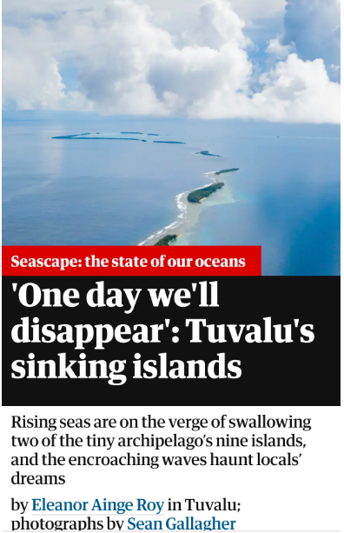
Heard of Tuvalu?

Slide 12
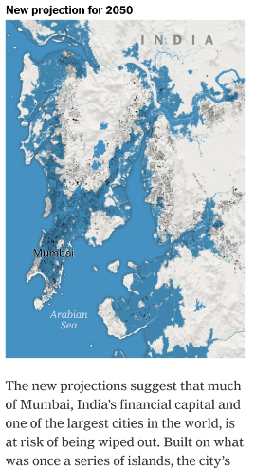
Amchi Mumbai!
Source: New York Times

Slide 13
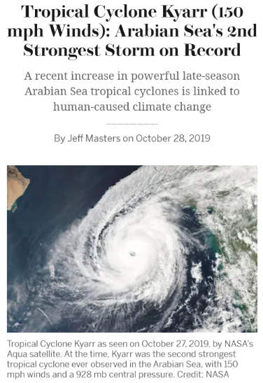
Source: Scientific American

Slide 14
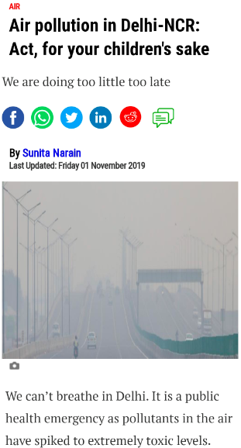

Slide 15

What more??

Slide 16
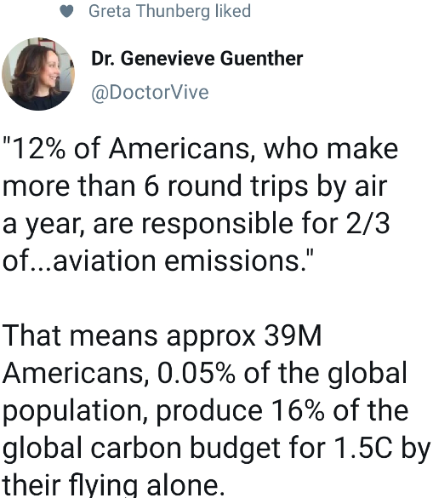
#flightshame: aka Carbon Footprint!

Slide 17
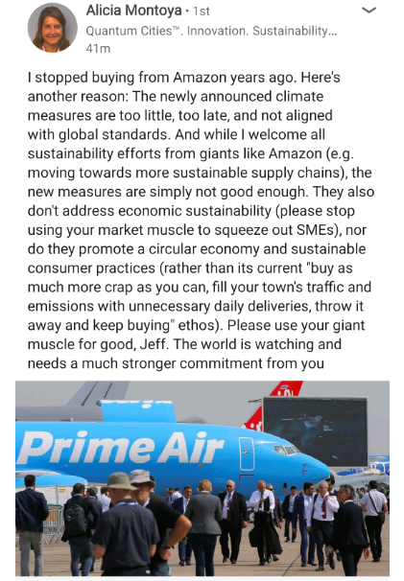
Diminishing Trust!

Slide 18
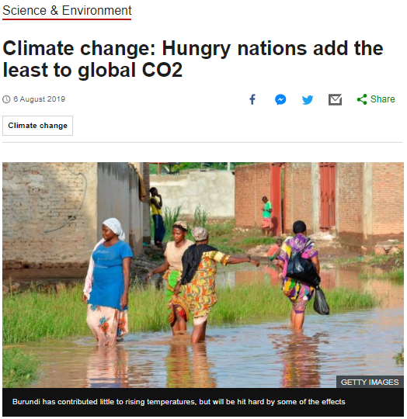
Whither equity?

Slide 19

Extinction Rebellion!

Slide 20
New risks: ‘Asbestosis’ 2.0?
“A new, highly complex and destabilised domain of risk is emerging… affects virtually all areas of policy and politics, and it is doubtful that societies - are adequately prepared to manage this risk.”
Institute of Public Policy Research

Slide 21
Third Pole

Slide 22
Lessons from Aarey
Governance cannot be a cat and mouse game with the people. They must be treated as stakeholders.
Source: Indian Express

Slide 23
ESG & the new performance metrics!
Principles of Responsible Investments (PRI)
Principles of Sustainable Insurance (PSI)

Slide 24
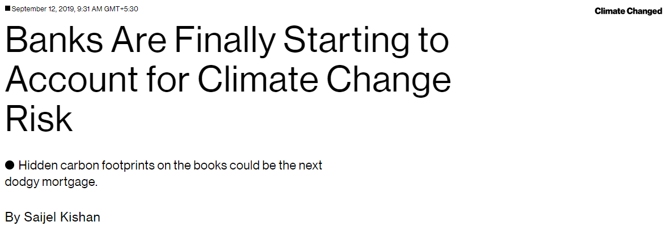
For banks, one concern is that if society ignores the problem and is later forced to transition quickly to a low-carbon economy, companies and assets that produce a lot of emissions might see a sudden collapse in value. Stranded Assets?

Slide 25
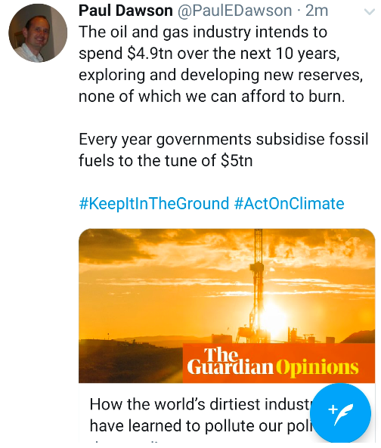
Stranded Assets?

Slide 26
Climate bankruptcy!
PG&E Corporation, California:
With potential claims worth $30 billion and 750 lawsuits in offing, the company opted for the dubious distinction of becoming the first major corporate casualty of climate change.

Slide 27
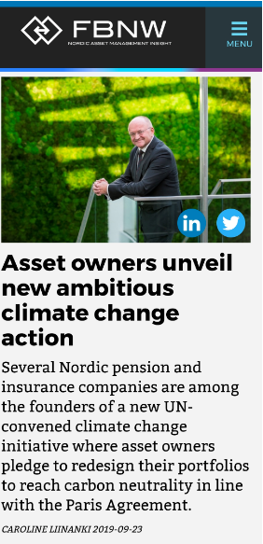
Big money’s ‘groundswell shift’ on climate risks!

Slide 28
The Church of England crusades against big oil!
Like Exxon, Shell once refused to commit to carbon reduction targets. But late last year, under pressure from shareholders, the company finally agreed to a 20% cut by 2035 and a 50% cut by the middle of the century. It even made the payment of executive bonuses dependent on progress towards those targets.
Source: marketplace.org

Slide 29
No escaping: Fiduciary Duties!
While companies are currently not required to comply with the TCFD, financial regulators and courts are increasingly recognising that directors have a fiduciary duty to assess, manage and report to shareholders on all key risks.
Tim Buckley
Director of Energy Finance Studies, Australasia

Slide 30
Not just #Sustainability!
The scope of the ASFI is to develop a Sustainable Finance Roadmap, recommending pathways, policies and frameworks to meet its objectives:
Mobilising sustainable development goals, based on science-based targets and international standards,
Embed sustainability and human rights considerations in financial markets to better account for and manage risk,
Enhanced disclosures and transparency in financial markets in relation to environmental and social risks and opportunities, and
A financial system that meets community and consumer expectations around sustainability.
Source: actuaries.digital blog

Slide 31
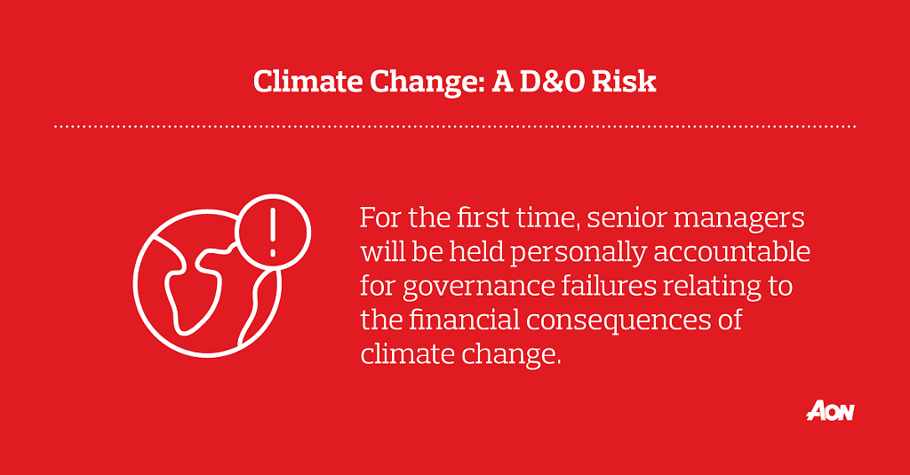
SMCR: October 15, 2019!

Slide 32
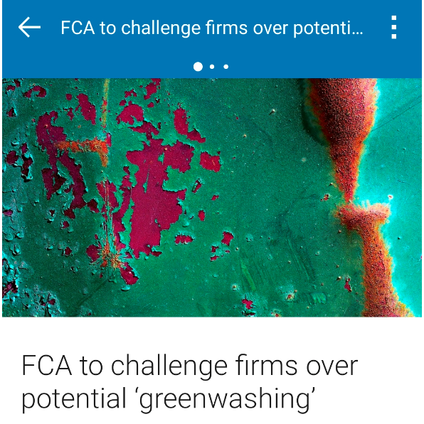
Greenwashing!

Slide 33
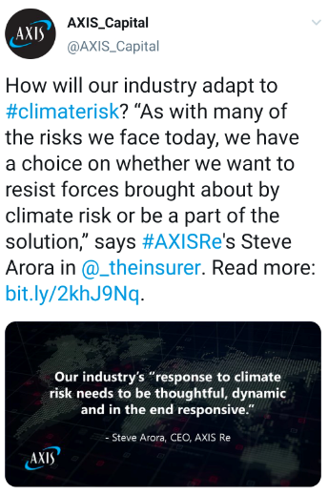
Decarbonise!

Slide 34

Beyond taste busting!

Slide 35
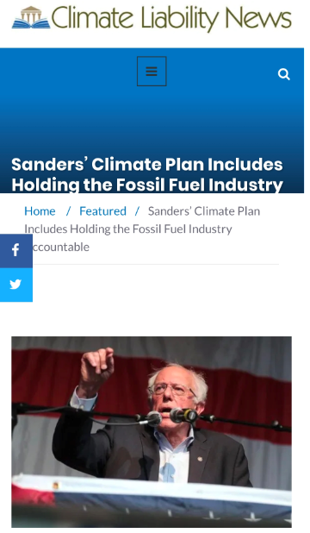
Carbon Tax!

Slide 36

Redlining!

Slide 37
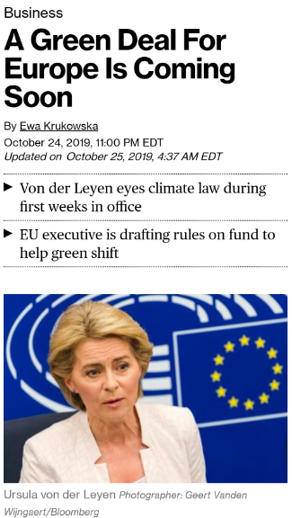
‘GDPR’ 2.0?

Slide 38
Wake-up & Act!
And it’s all converging into Board-rooms!

Slide 39
Insurers must come onboard, too!
In the last two and a half years, 17 international insurance companies - including the world’s biggest primary insurers - have stopped or limited insuring coal, and more than 30 have divested their assets from the coal industry.
Peter Bosshard
www.thediversityblog.com

Slide 40

Greta Effect!

